Slide 1
Introduction to the Nature of Science
Mr. Le
Physical Science
Fall 2013

Slide 2
Look at the picture to your left and tell me two things you see.
Make an observation.

Slide 3
Now look at the picture tell me what you see.
Make an observation.

Slide 4
Now look at the picture and tell me what you see.
Make an observation.

Slide 5
Observation
Observation- Gathering information based on your five senses: touch, taste, sight, smell, hearing
Examples:
The sock is stinky.
The drums were loud.
The rocks are sharp.
The medicine was bitter.

Slide 6
Inference
Inference- Explanation of an observation based on prior knowledge and experience
Example:
The ground is wet, so it must have rained
recently.
Emma is not here today, so she must be
sick.

Slide 7
Observation Inference
Gather information based on five senses (sight, smell, taste, touch, hear)
Factual (True, can not be false) Know
What it is
Collecting Data
Explains observation base on prior knowledge (what you already know
Assume to be true (could be false) Think
What it might be
Drawing conclusions from collected data

Slide 8
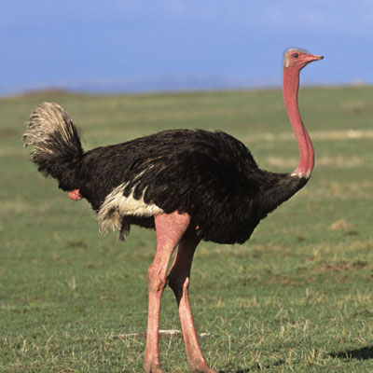
Observation or Inference?
This animal has a black body.
This animal can fly
This animal can run fast.

Slide 9
Quantitative versus Qualitative Data
Quantitative (quantity) = measures what we observe. Numeric value = number
Example: The car has four wheels
Example: There were 7 paperclips in the basket.

Slide 10
Quantitative versus Qualitative Data
Qualitative (quality) = describes what we observe.
Example: The car is red.
Example: The paperclips are inside the basket

Slide 11
Works Cited
http://mysciencelessons.wordpress.com/2009/09/21/mystery-footprints/

